Slide 1
Single Qubit Clifford Sequences Experiment using Gate Insertion and Pulse Stretching
Meeting with Professor Schnetzer
September 9, 2020

Slide 2
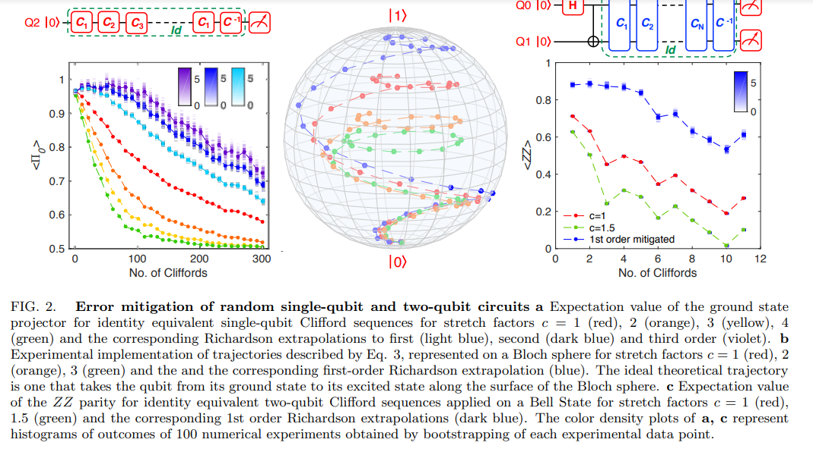
Reproducing the following figure from Kandala paper

Slide 3
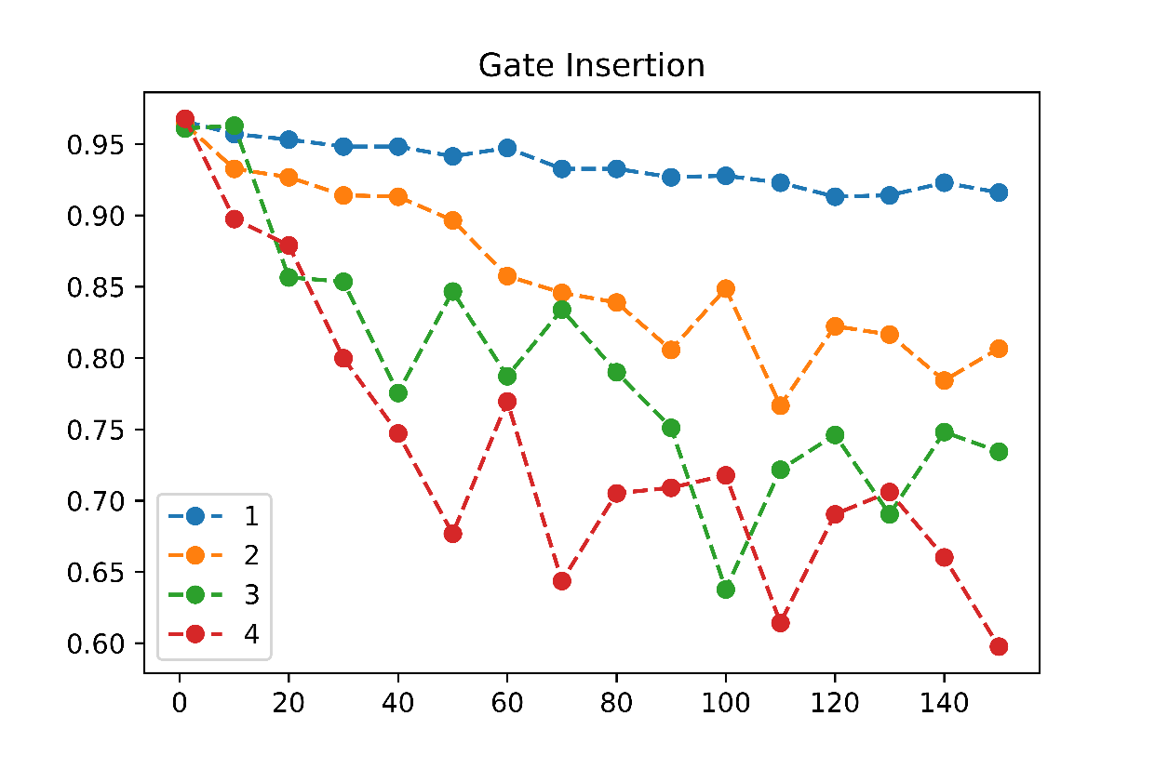
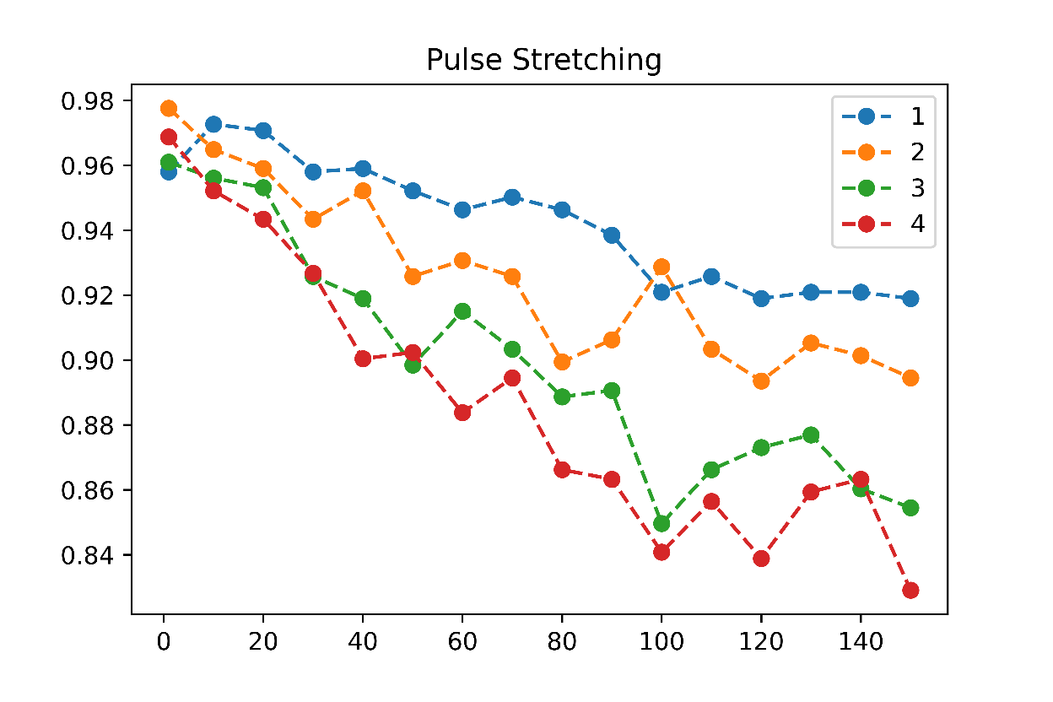
Noise Stretch Factors: 1,2,3,4
Gate Insertion
Pulse Stretching

Slide 4
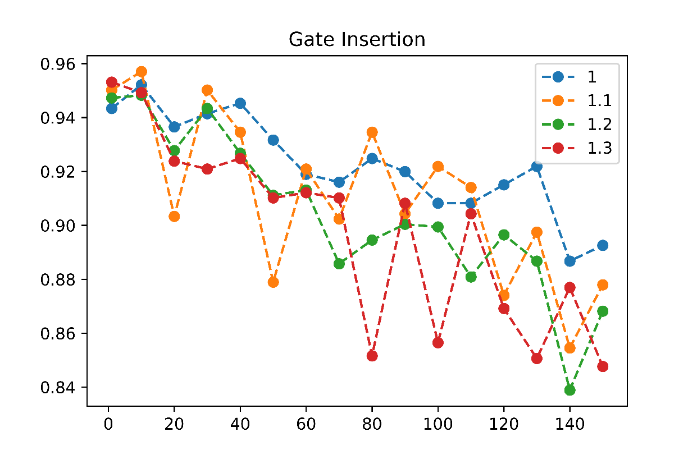
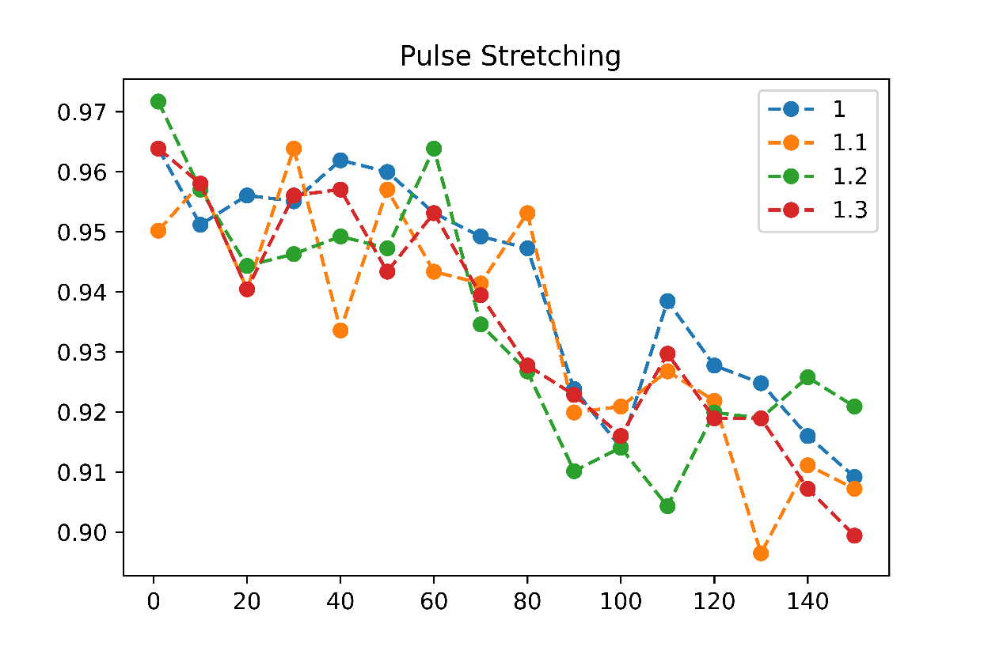
Noise Stretch Factors: 1, 1.1, 1.2, 1.3
Gate Insertion
Pulse Stretching

Slide 5
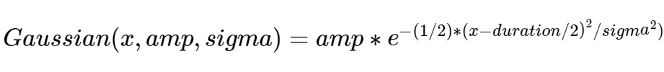
Methods
Gate Insertion
Pulse Stretching
For a given gate length x:
Generate x Clifford gates adding up to an identity
For a given scale factor c:
Use Random Identity Insertion Method (after every gate in the circuit, add x identities where x is sampled from a Poisson distribution with mean (c-1)/2
For a given gate length x:
Generate x Clifford gates adding up to an identity
For a given scale factor c:
Each U3 gate in the circuit has some associated DRAG pulse (Derivative Removal by Adiabatic Gate)
Thus pulse is a function of duration, amplitude and sigma (width of Gaussian)
To stretch the pulse,
New Duration = c*duration
New amp = amplitude/c
New sigma = c*sigma

